Slide 1
Introducing PALASO 2015
A tour of features
Presented By

Slide 2
PALASO 2015
A set of DotNet libraries useful for developers of Language Software.
Easy Plug-in
Less work
Rich UI
Enhance your application

Slide 3
Palaso
Payap Language Software Development Group (PALASO)
is part of the Linguistics Institute at Payap University in Chiangmai Thailand. The Linguistics Institute is a partnership between Payap University and SILInternational
with the mandate to serve the language communities of Southeast Asia through linguistic research and language development.
The Palaso Group develops new software to aid linguistic research and language development.

Slide 4
Who are all Developers of Palaso

Slide 5
Developers – Papua New Guinea
Cambell Prince
Robin Munn
Chris Hirt
Ira Hopkinson
John Hatton

Slide 6
Library
SayMore
WeSay
LiftTools
Solid
myWorkSafe
Boom
pdfDroplet
Phonology Assist
HearThis
Fieldworks

Slide 7
Palaso Library Features
UI
Tests
Media
Dictionary
XML
Scripture
Enchant
Archiving
Reporting
Email
LIFT

Slide 8
Features

Slide 9
UI…
Clear Share
File Dialog Extender
Confirm Recycle Dialog
Folder Browser Control
HotSpot
HtmlBrowser
Image Gallery
Image Toolbox
Keyboarding
Progress
Proxy Settings
Command Line Processing
Registration
Release Notes
Reporting ( Exception)
Setting Protection
SIL About Dialog Box
Spelling
ToolTip
Widgets
Writing Systems
Others Tools(Color Helper, Screen Helper, Font Helper, Painting Helper)

Slide 10

Media…

Slide 11

Scripture…

Slide 12
Archiving…
Ramp Package

Slide 13

Email…

Slide 14
Test…
Nunit

Slide 15
Dictionary…
Lift Reader
Lift Writer
Lift Mapper

Slide 16
Enchant…
Enchant is a spell-checking framework that allows you to use many different spell-checking backends, including Aspell, Hunspell, and Ispell.

Slide 17
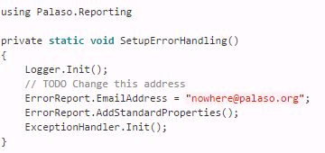
Reporting…

Slide 18
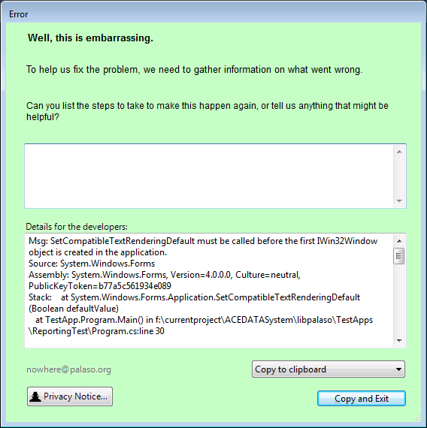
Reporting…

Slide 19
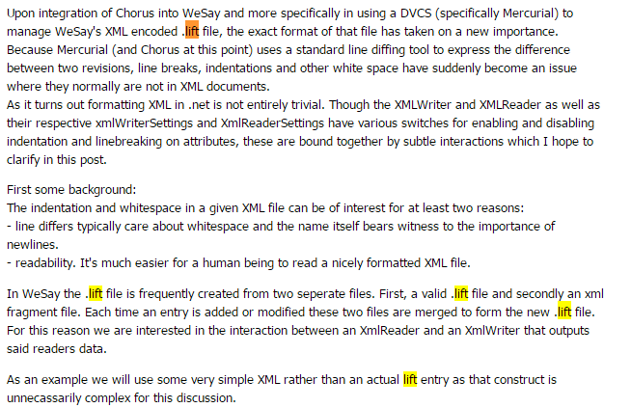
LIFT

Slide 20
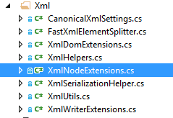
XML

Slide 21
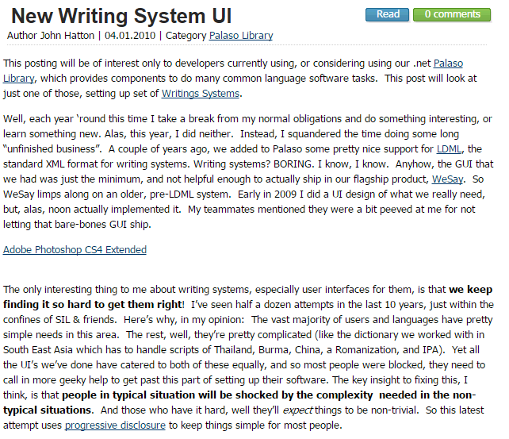
Writing System - LDML

Slide 22
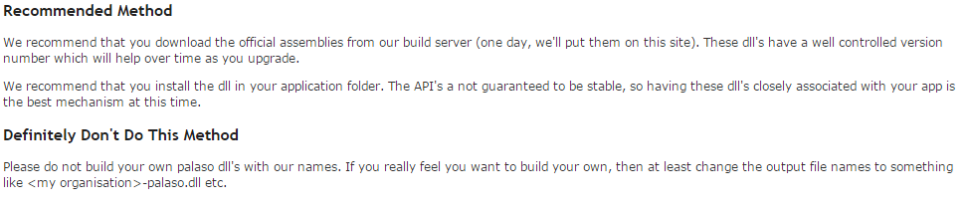
Redistribution

Slide 23
Questions

Slide 24
Thank you
Happy Coding

